Slide 1
TAK Server Multicast MANET vs Unicast Infrastructure

Slide 2
TAK Server – Unicast
Unicast is a point-to-point communication between the sender and receiver.
TCP: (Transmission Control Protocol) Connection-oriented protocol that relies on acknowledgement from the receiver side.
HTTP: (HyperText Transfer Protocol) Object-oriented protocol for communication, designed to transfer information between networked devices.
Unicast provides better security and reliability when sending sensitive information as the transmission only goes to one location.

Slide 3
TAK Server – Unicast
Major Protocols of Unicast Routing:
Distance Vector Routing: uses a distributed algorithm to compute their routing tables.
Line-State Routing: uses link-state routers to exchange messages that allow each router to learn the entire network topology.
Path-Vector Routing: protocol that maintains the path which is updated dynamically.

Slide 4
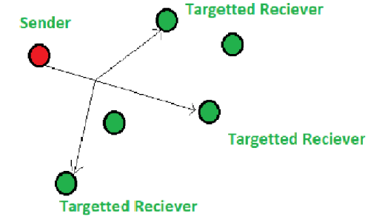
TAK Server – Multicast
Multicast is a data transmission method where data is sent from one source to multiple destinations simultaneously.
Multicast:
Allows for more efficient use of bandwidth and provides faster transmission speeds for large amounts of data.
Reduces the amount of data sent over a network.

Slide 5
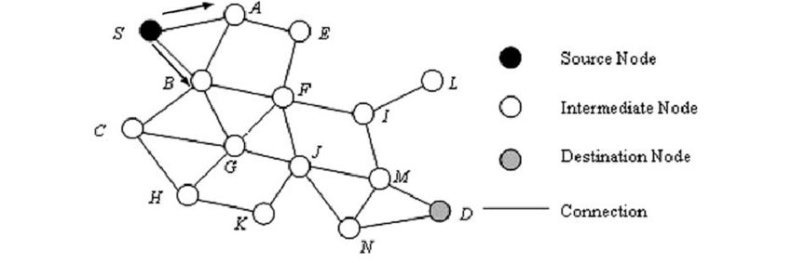
TAK Server – MANET
MANET (Mobile Adhoc Network) – is a collection of low-power wireless mobile nodes forming a temporary wireless network without the aid of an established infrastructure or centralized administration.
Ad Hoc – create or done for a particular purpose, as necessary.
MANET nodes are free to move randomly as the network topology changes. Each node behaves as a router as it forwards traffic to other specified nodes in the network.

Slide 6
TAK Server – MANET
When a new node enters the adhoc network it must announce its arrival/presence and listen to similar announcement broadcasts made by other mobile nodes.
Advantages:
Separation from central network administration.
Each node can play the roles of router and host.
Self-configuring and self-healing nodes.
Highly scalable
Disadvantages:
Resources are limited due to constraints like noise, interference conditions, etc.
Lack of authorization facilities.
More prone to attacks due to limited physical security.
High latency.

Slide 7
TAK Server – MANET
Protocols:
Proactive Routing Protocol: Ever node keeps a separate routing database that lists the paths to every potential destination node.
Updates whenever there is a change to the topology of the network.
Struggles with large networks.
Reactive Routing Protocol (on-demand routing): The route is discovered only when it is required/needed.
Phase 1: Route Discovery: Determines the most optimal path for transmission from the root node to the destination node.
Phase 2: Route Maintenance: Performs the maintenance work for the route as the topology changes.
Hybrid Routing Protocol: The source and destination node’s zones and positions are considered when the protocols are adjusted.
The network is divided into different zones and then the position of the source and destination nodes are observed. If they are present in the same zone, then proactive routing is used to transmit the data packets between them. If they are not in the same zone, reactive routing is used to transfer the data packets between them.

